Slide 1
Reliability
Reliability is one of the metrics that are used to measure quality.
If the users of a system rarely experience failure, the system is considered to be more reliable than one that fails more often.
A system without faults is considered to be highly reliable.

Slide 2
Key concepts
Failure
If observable outcome of a program execution is different from the expected outcome.
Fault
Cause of failure(condition that causes software to fail)
Time
If the time gap between two successive failures is short, we say that the system is less reliable. Two types of time models are:
Execution time(actual CPU time taken to execute)
Calendar time (regular time that we use)

Slide 3
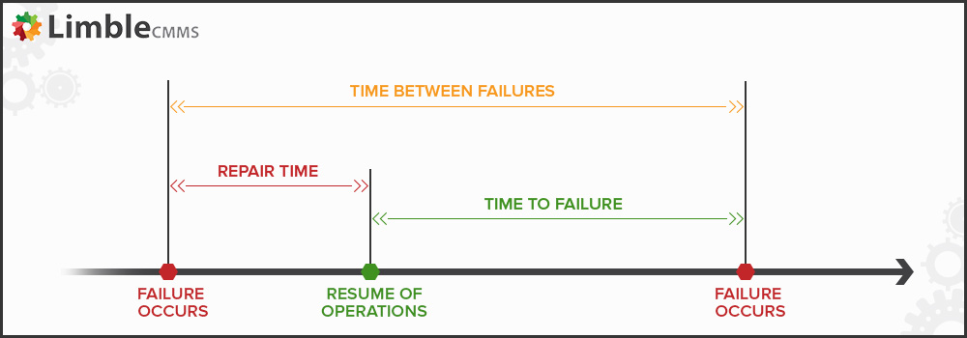
MTTF: Mean Time To Failure
MTTR: Mean Time To Repair
MTBF: Mean Time Between Failures (= MTTF + MTTR)

Slide 4
IEEE
Failure: External behavior is incorrect
Fault: Discrepancy in code that causes a failure.
Error: Human mistake that caused fault

Slide 5
Definition of Software Reliability
First definition
Software reliability is defined as the probability of failure-free
operation of a software system for a specified time in a specified environment.
Key elements of the above definition
Probability of failure-free operation
Length of time of failure-free operation
A given execution environment
Example
The probability that a PC in a store is up and running for
eight hours without crash is 0.99.

Slide 6
Second definition
Failure intensity is a measure of the reliability of a software system operating in a given environment.
Example: An air traffic control system fails once in two years.
Comparing the two
The first puts emphasis on MTTF, whereas the second on count.

Slide 7
Factors influencing software reliability
User’s perception- Reliability of a software depends upon two categories of information.
The number of faults present in the software
The ways user operate the system-Operational profile

Slide 8
Fault count is influenced by following:
Size and complexity of code
Characteristics of development process used
Education, experience and training of development personnel
Operational Environment

Slide 9
Operational Profile
An OP describes how actual users operate a system.
Two ways to represent operational profiles
Tabular
Graphical

Slide 10
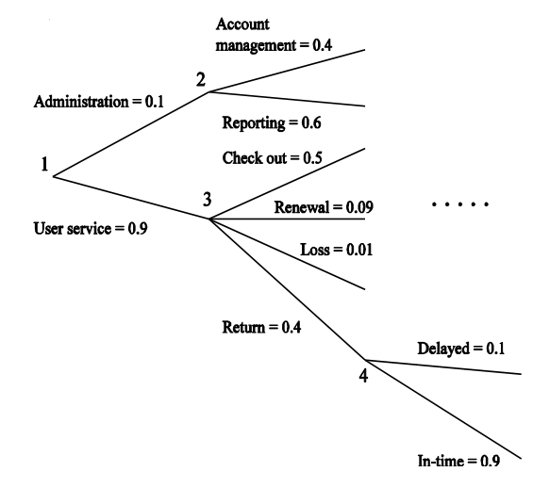
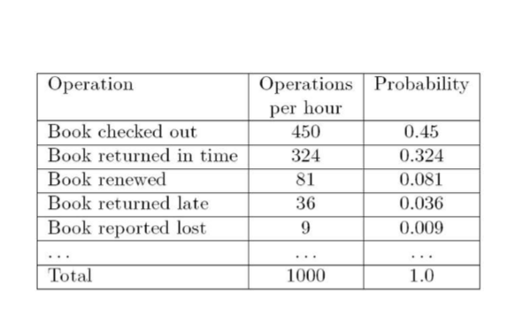

Slide 11
Use of OP in different ways
Use an OP as a guiding document in designing user interfaces.
Use an OP to design early version of a software for release
Use an OP to determine where to put more resources in a software.
Note: For accurate estimation of reliability of a system, test the system in the same way it will be actually used in the field.

Slide 12
Software reliability methodologies
Critical systems (spacecraft, aircraft, nuclear power plant etc. ) require a high level of dependability in their operation. Dependability means
Fault avoidance
Fault tolerance
Fault removal
Fault forecasting

Slide 13
Fault avoidance
Prevent the introduction of faults during the development of the software
How?
Use standards and guidelines
How to implement the code?
When and where to use functions, pointers etc.,
Use formal methods
to verify system working
Methods against software aging
to prevent memory leaks-system crash

Slide 14
Fault tolerance
Used to address the shortcoming of fault avoidance
How?
By mitigating the risks
there will be some potential or hidden faults remaining in software.

Slide 15
Fault removal
Aim at detecting and fixing faults once the code has been developed
How?
Testing techniques
Using various methods and verification
Analysis ( Dynamic , Semantic etc.,)

Slide 16
Fault forecasting
Estimating the presence of faults.
Occurrence and consequences of failure.
Main aim of fault forecasting is predicting the reliability of a software product reliability.
They are mainly concerned with reliability models.

Slide 17
SOFWARE RELIABILITY METRICS
Probability of failure on demand
Rate of occurrence of failure
Mean time to failure
Availability

Slide 18
Why Software Reliability Models?
The fault forecasting methodologies includes the reliability models.
Return us the reliability of the software or predict the reliability of the software.

Slide 19
SOFTWARE REUSE
Software reuse is the process of implementing or updating software systems using existing software components.
To achieve better software quality more quickly at lower costs, software engineers are beginning to adopt systematic reuse as a design process.

Slide 20
PURPOSE
CHEAPER PRODUCTS : It includes shorter development time, easier maintenance
BETTER QUALITY PRODUCTS : Code that was written for reuse should has better specifications and should be thoroughly tested

Slide 21
BENEFITS OF REUSE
It is cheaper
It produces less buggy code
It saves your time since you don’t have to continuously reinvent the wheel
It also helps the developers
Higher quality products
Less development time

Slide 22
TYPES OF REUSE
Concerning motivation and driving factors, reuse can be :
Opportunistic - While getting ready to begin a project, the team realizes that there are existing components that they can reused.
Planned - A team strategically designs components so that they'll be reusable in future projects.

Slide 23
CONT.
Application System Reuse - It is concerned with reusing an entire application inside another
Component Reuse - It is concerned with components of one application reused in another application.

Slide 24
BARRIERS TO MAKING SOFTWARE AVAILABLE FOR REUSE
Increased maintenance cost
Lack of tool support
Lack of knowledge.

